Slide 1
Focus on Pharmacology:
Essentials for Health Professionals
Third Edition
Chapter 13
Dietary Supplements and Alternative Therapies

Slide 2
Introduction
Herbal and nonherbal supplements
  Used regularly by more than 158 million Americans
  Easily purchased over-the-counter (OTC)
Phytomedicine is the use of plants, plant parts for therapies.
About 80% of the world uses herbal remedies as primary health care
  Patients using supplements (or alternative therapies) must discuss these with a physician to avoid interactions and potential adverse effects.

Slide 3
Herbal Supplements
Any mixture of ingredients based on plant sources
  Designed for better health, or treatment of certain conditions
Considered by FDA to be food products, not drugs
Often supplement traditional medicine
continued on next slide

Slide 4
Herbal Supplements
Taking herbal supplements should not occur without consulting physician.
Not regulated by FDA
  No independent verification of quality, effectiveness, or quantity of ingredients
  Some herbs contain substances toxic to the body or liver.
  Others are carcinogenic, mutagenic, or teratogenic.
continued on next slide

Slide 5
Herbal Supplements
Many different forms
  Capsules
  Liquids
  Powders
Many people believe "natural" supplements have stronger healing properties than “synthetic” drugs.
No real testing occurs
continued on next slide

Slide 6
Herbal Supplements
Herb
  A botanical product without stems or bark
  Used for thousands of years to treat many different conditions
Complementary and alternative medicine (CAM)
  Involves different healing systems and therapies, including:
    Herbal therapies
    Nutritional supplements
    Special diets
continued on next slide

Slide 7
Herbal Supplements
Most modern drugs contain only one active ingredient.
  Standardized
  Measured with accuracy
Many supplements contain active ingredients in varying quantities, strengths.
  May contain active chemicals
    Not working well together for a controlled effect

Slide 8
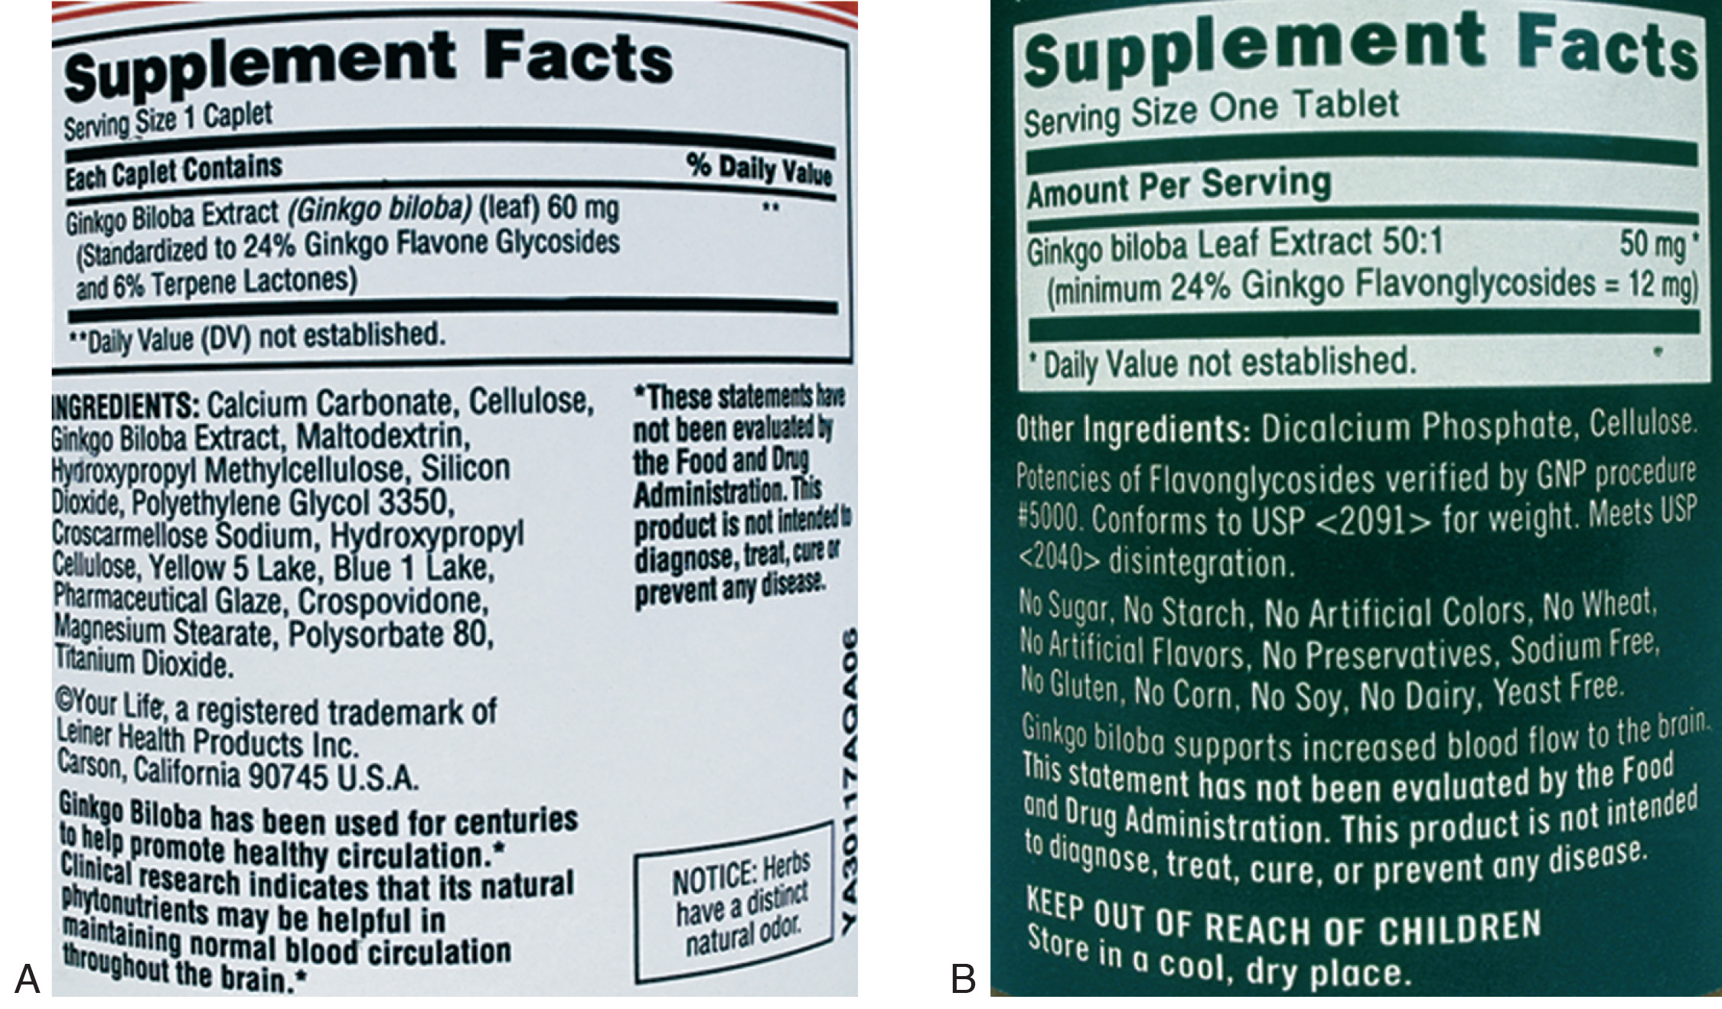
Figure 13-1 Two ginkgo biloba labels: note the lack of standardization in (A) 60 mg of extract, 24% ginkgo flavone glycosides and 6% terpenes; and (B) 50:1 ginkgo leaf extract, 24% ginkgo flavone glycosides.
Al Dodge/Pearson Education, Inc.

Slide 9
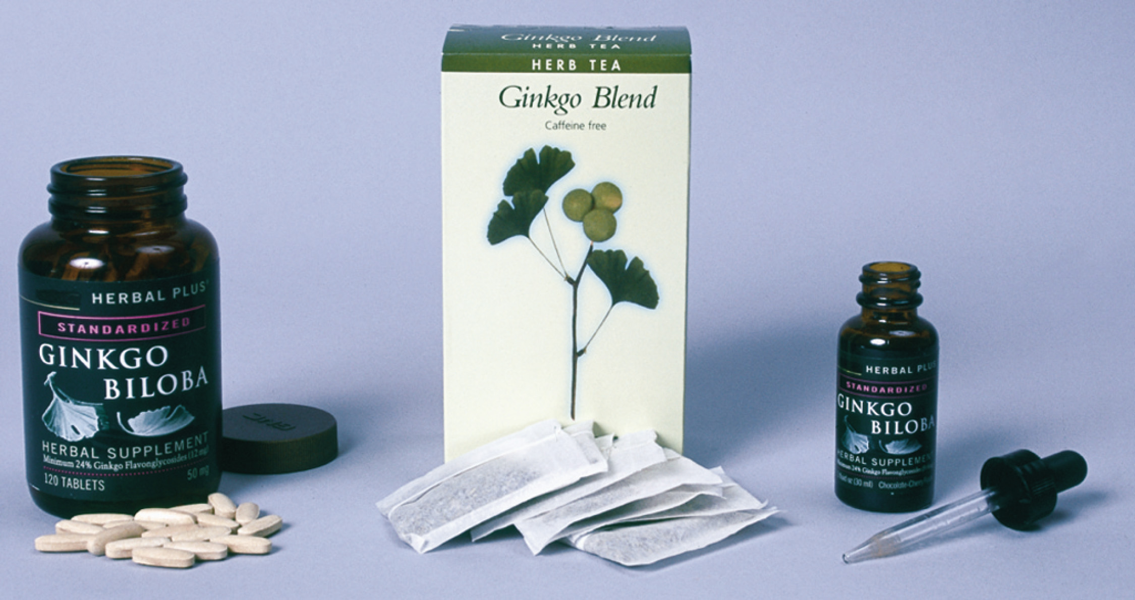
Figure 13-2 Three different ginkgo formulations: tablets, tea bags, and liquid extract.
Al Dodge/Pearson Education, Inc.

Slide 10
History of Supplements
Herbs and botanicals
  May have healing, flavor-enhancing, food-enhancing properties
One of the first uses of herbs was garlic.
  Prescribed for a medical condition in 3,000 B.C.
Use of herbs began to decline in late 1800s.
  Increased regulation
    Many herbal products removed
continued on next slide

Slide 11
History of Supplements
In the 1970s, there was a resurgence in use.
  Many older Americans want cheaper treatments with more effect than prescription medications

Slide 12
Legislation Concerning Supplements
Dietary Supplement Health and Education Act (DSHEA) of 1994
  Regulated herbal supplements
  Manufacturers must label them as dietary supplements
    Intended to enhance or supplement diet
  Includes botanicals, vitamins, minerals, extracts or metabolites not approved as drugs by FDA
continued on next slide

Slide 13
Legislation Concerning Supplements
DSHEA established Office of Dietary Supplements (ODS)
  Part of the National Institutes of Health (NIH)
  To coordinate research and publish information on supplements
National Center for Complementary and Alternative Medicine (NCCAM)
  Coordinates research and training about CAM
continued on next slide

Slide 14
Legislation Concerning Supplements
No real standardization for dietary supplement industry
Effectiveness and safety do not have to be proven before supplements are sold.
Labeling still makes inaccurate claims.
The term “natural” does not ensure safety.
continued on next slide

Slide 15
Legislation Concerning Supplements
The Dietary Supplement and Nonprescription Drug Consumer Protection Act
  Manufacturers must include contact information on labels for consumers so adverse effects can be reported.
    Manufacturers must inform FDA of such occurrences within 15 days after receiving a consumer complaint.
    Manufacturers must keep records of these events for at least 6 years.
continued on next slide

Slide 16
Legislation Concerning Supplements
Medical histories must include lists of herbal supplements to track effects and interactions with drugs.
Products may cause allergic reactions due to incomplete ingredient lists.
  Supplements should never be taken with insulin, warfarin, digoxin without talking to a physician.
continued on next slide

Slide 17
Legislation Concerning Supplements
Safety Ratings for Herbal Products
  Assigned by American Herbal Products Association (AHPA):
    Class 1 – safely consumed with proper use
    Class 2 – usage restrictions, unless directed by an expert
      2a – for external use only
      2b – not to be used during pregnancy
      2c – not to be used during lactation and nursing
      2d – other specific use restrictions, as noted
    Class 3 – used only with supervision of a qualified expert
    Class 4 – insufficient data available for classification

Slide 18
Commonly Used Herbal Supplements with Potential Interactions
Aloe
  Digoxin
  Anti-diabetes agents
  Sevoflurane
  Stimulant laxatives
  Warfarin
  Diuretics
continued on next slide

Slide 19
Commonly Used Herbal Supplements with Potential Interactions
Black cohosh
  Antihypertensives
  Hormone replacements
  Oral contraceptives
  Sedatives/hypnotics

Slide 20
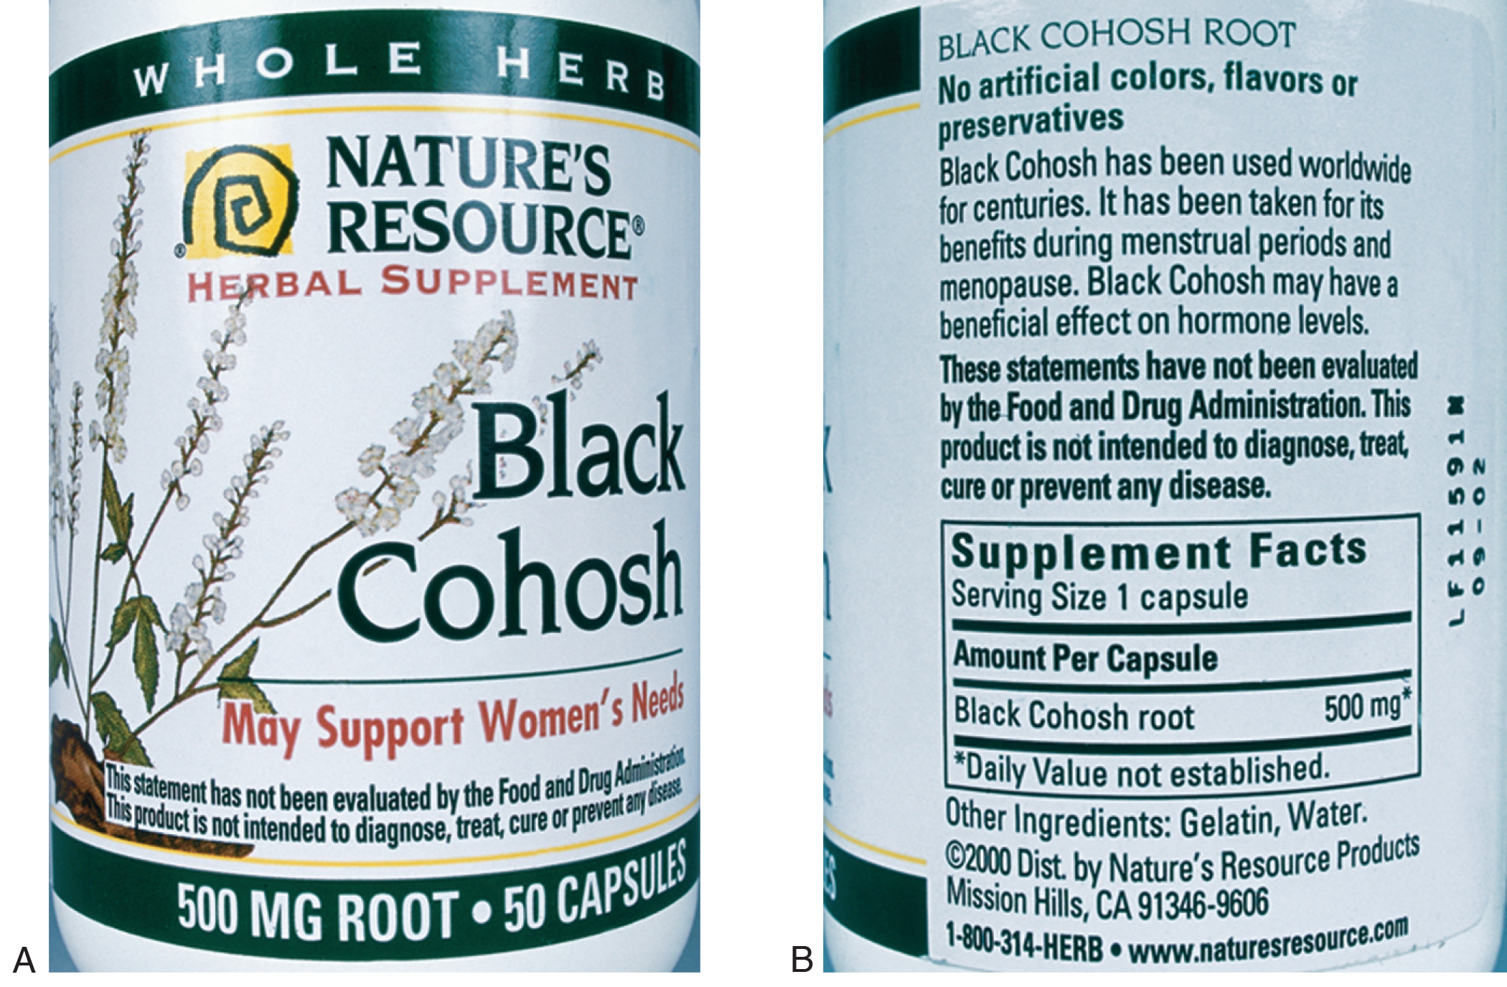
Figure 13-3 Labeling of black cohosh: (A) front label with general health claim and (B) back label with more health claims and FDA disclaimer.
Al Dodge/Pearson Education, Inc.

Slide 21
Commonly Used Herbal Supplements with Potential Interactions
Ginseng
  CNS depressants
  Digoxin
  Diuretics
  Insulin
  Hypoglycemics
  Warfarin
  Antidepressants
  Mood stabilizers
  Antiestrogens
  Anxiolytics
  Antihypertensives
continued on next slide

Slide 22
Commonly Used Herbal Supplements with Potential Interactions
Horny goat weed
  Antihypertensives
  Anticoagulants
  Antiplatelet agents
  NSAIDs
  Thrombolytics
  Ticlopidine
  Tirofiban
  Warfarin
continued on next slide

Slide 23
Commonly Used Herbal Supplements with Potential Interactions
Melatonin
  CNS depressants
  Contraceptives
  Caffeine
  Fluvoxamine
  Anti-diabetes agents
  Immunosuppressants
  Anticoagulants
  Anti-platelet agents
  Benzodiazepines

Slide 24
Other Herbal Supplements with Significant Drug Interactions
Alfalfa
Astragalus
Bilberry
Cayenne
Chamomile
continued on next slide

Slide 25
Other Herbal Supplements with Significant Drug Interactions
Cranberry
Dong quai
Echinacea
Feverfew
Garlic
continued on next slide

Slide 26
Other Herbal Supplements with Significant Drug Interactions
Ginger
Ginkgo
Green tea
Kelp
Parsley
continued on next slide

Slide 27
Other Herbal Supplements with Significant Drug Interactions
Red clover
Rose hips
Saw palmetto
Soy
Valerian
Yohimbe

Slide 28
Nonherbal Supplements
Specialty supplements
May be obtained from many different animal or plant sources
Usually more specific in action than herbals
Should be used only for specific conditions

Slide 29
Table 13-2 Nonherbal Supplements
SUPPLEMENT | USES | POTENTIAL INTERACTIONS
Chondroitin | For osteoarthritis and other arthritic conditions | Warfarin
Chromium | Increases athletic performance; for non-insulin-dependent diabetes | Insulin or other diabetes medications, antacids, acid reflux drugs, corticosteroids, beta-blockers, and NSAIDs
Glucosamine (must be used with caution by diabetic patients) | For osteoarthritis and other arthritic conditions | Warfarin, antimitotic chemotherapeutics, acetaminophen, diabetes medications
continued on next slide

Slide 30
Table 13-2 Nonherbal Supplements
SUPPLEMENT | USES | POTENTIAL INTERACTIONS
S-adenosyl-L-methionine (SAM-e) (must be used with caution in patients with bipolar or movement disorders who are taking serotonin-enhancing drugs) | For depression and osteoarthritis; less studied uses include liver disease, fibromyalgia, Alzheim- er’s disease, pain, migraine, and bursitis | Antidepressants, MAOIs, dextromethorphan, levodopa, meperidine, pentazocine, tramadol

Slide 31
Alternative Therapies
“Outside” mainstream health care
  Focus on treating each person individually
  CAM
    Emphasizes integration of mind and body.
    Promotes disease prevention, self-care, self-healing
    Recognizes spirituality as a component
continued on next slide

Slide 32
Alternative Therapies
Health care professionals should be sensitive to patients’ beliefs.
Advantages and limitations should be explained to patients so they can make accurate choices about care.
Most cultural groups in the U.S. use “home” or “folk” remedies.

Slide 33
Complementary and Alternative Medicine Therapies
Acupuncture
Chiropractic
Homeopathy
Native American medicine
Naturopathy
continued on next slide

Slide 34
Complementary and Alternative Medicine Therapies
Herbs
Supplements
Special diets
Massage
Physical therapy
continued on next slide

Slide 35
Complementary and Alternative Medicine Therapies
Biofeedback
Hypnotherapy
Meditation
Yoga
Prayer

Slide 36
Home and Folk Remedies as Alternative Therapies
Crunchy fruits, vegetables
  Tooth whitening
Baking soda in water
  Urinary tract infections
Bay leaf
  Bronchitis
continued on next slide

Slide 37
Home and Folk Remedies as Alternative Therapies
Hot chicken soup
  Cold, fever, flu
Eucalyptus oil
  Mucus reduction, sore throat
Honey
  Antiviral and antibacterial agent
continued on next slide

Slide 38
Home and Folk Remedies as Alternative Therapies
Olive oil
  Eczema
Turmeric
  Cough, anti-inflammatory uses

